Slide 1
Dynamics 365 Post Go-Live Workshop
24 August, 2021

Slide 2
Post Go-Live Workshop Agenda
Agenda
The Post Go-Live Workshop is designed to wrap up the FastTrack engagement.
During this workshop, we’ll work through the initial customer goals/objectives and discuss the lessons that have been learned.
We’ll then look at the available Microsoft Support plans.
Finally, we’ll explore the opportunities to share through the Customer Advocacy Program.
Key accomplishments: review of goals and objectives
Discussion of lessons that have been learned
Post Go-Live Assessment
Looking Forward
Your Microsoft Account Team
Microsoft Dynamics 365 Support Options
Format: 90-minute Microsoft Teams call
Attendees: Key stakeholders from the customer and partner teams. Project managers, Architects, and Project Sponsors are mandatory
Microsoft Customer Advocacy Program
Q&A and Next Steps

Slide 3
Key accomplishments: review of goals and objectives
Customer slide (please update)
Review of goals and objectives
Add info:
List key accomplishments in the implementation journey

Slide 4
Discussion of lessons that have been learned
Customer slide (please update)
Lessons learned in regard to the project execution and implementation
Add Info
List the top challenges faced during the project delivery and the related lessons learned
Lessons learned in regard to the Dynamics 365 solution
Add Info
List the top challenges with the Dynamics 365 and the related lessons learned

Slide 5
Post Go-Live Assessment
Customer slide (please update)
Share your feedback/rating in the following areas
TOPIC | SUB-TOPIC | FEEDBACK | RATING (1-10) 10 is best
Overall satisfaction with the solution | Dynamics 365 solution | Add info: Share your constructive feedback in this area
Satisfaction with the FastTrack engagement | Satisfaction with the FastTrack engagement | Add info: Share your constructive feedback in this area
Business metrics | Operational efficiency | Add info: Share your constructive feedback in this area
Value of investment | Total Cost of Ownership | Add info: Share your constructive feedback in this area
 | Return on Investment | Add info: Share your constructive feedback in this area

Slide 6
Post Go-Live Assessment
Customer slide (please update)
Share your feedback/rating in the following areas
TOPIC | SUB-TOPIC | FEEDBACK | RATING (1-10) 10 is best
Administration and Governance | Administration and governance | Add info: Share your constructive feedback in this area
Partner eco-system | Quality of execution | Add info: Share your constructive feedback in this area
 | Knowledge of partners | Add info: Share your constructive feedback in this area
 | ISV | Add info: Share your constructive feedback in this area
Support experience | Microsoft Support | Add info: Share your constructive feedback in this area

Slide 7
Post Go-Live Assessment
Customer slide (please update)
Share your feedback/rating in the following areas
TOPIC | SUB-TOPIC | FEEDBACK | RATING (1-10) 10 is best
Service health | Performance | Add info: Share your constructive feedback in this area
 | Service notifications | Add info: Share your constructive feedback in this area
 | Availability and reliability | Add info: Share your constructive feedback in this area
 | Monitoring and diagnostics | Add info: Share your constructive feedback in this area

Slide 8
Post Go-Live Assessment
Customer slide (please update)
Share your feedback/rating in the following areas
TOPIC | SUB-TOPIC | FEEDBACK | RATING (1-10) 10 is best
Application Lifecycle Management | Continuous updates | Add info: Share your constructive feedback in this area
Product roadmap and release cadence | Visibility and predictability | Add info: Share your constructive feedback in this area
Reporting and analytics | Out-of-box capabilities | Add info: Share your constructive feedback in this area
General | Other | Add info: Share your constructive feedback in this area

Slide 9
Looking Forward
Customer slide (please update)
The next milestones following this Go-Live
Add Info:
If relevant, share information about the upcoming phases and related timeline
Add Info:
If relevant, share information about the Dynamics or Power Platform footprint expansion
New projects launched with Microsoft solutions

Slide 10



What if you suspect something is wrong?
If you face a Service issue, take the following steps to improve awareness and get engaged
Check your Service Health Dashboard
at http://portal.office.com/Servicestatus
Contact Microsoft Support
via LifeCycle Services or via phone
Contact your Microsoft Representative:
Customer Success Manager,
Customer Success Account Manager or Account Executive

Slide 11











Getting Support from the right channels
Partner Support
Support Content
First Line
of Support
Task Guides
LCS
Docs
Learn
Tech Talks
Team Blogs
Community
Functional
Microsoft Support Plans
Technical
Unified Support
Professional Direct
Subscription
Implementation
Methodology

Slide 12
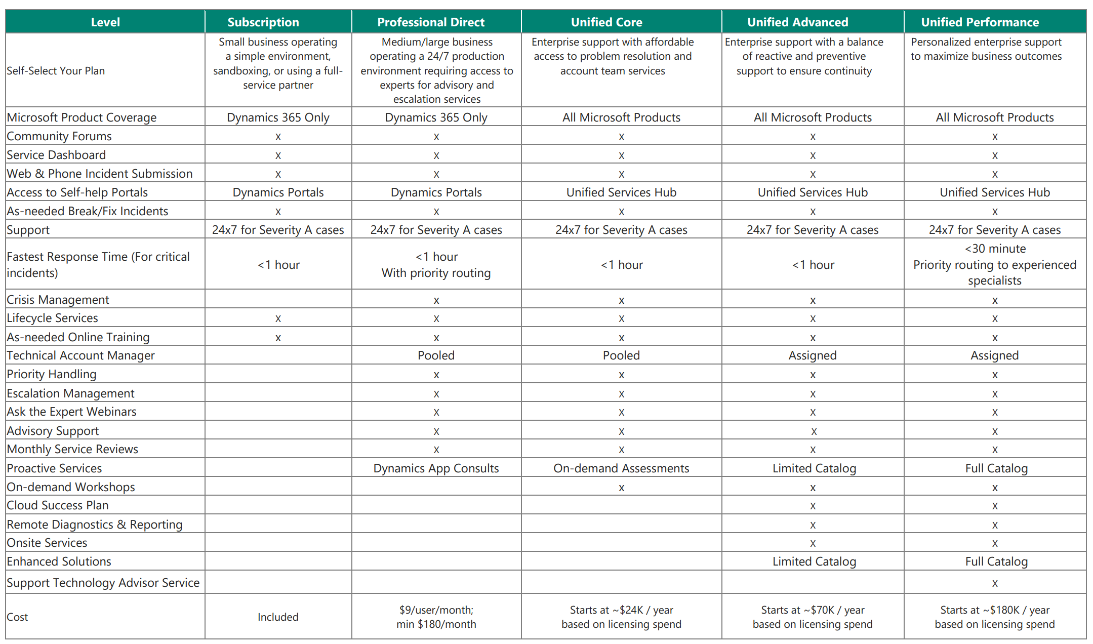
Choose the right support plan for your needs
Compare the Microsoft support plans using: https://dynamics.microsoft.com/en-us/support/plans/

Slide 13




Your Microsoft Account Team
The Account Executive | The Solution Sales Professional | The Customer Success Manager | The Customer Success Account Manager | The Dedicated Support Engineer
[AE_NAME] | [SSP_NAME] | [CSM_NAME] | [CSAM_NAME] | [DSE_NAME]
Manages the relationship between Microsoft and you including but not limited to Dynamics | Deals with anything related to licensing or purchase of Dynamics 365 | Focuses on the deployment and post Go-Live success with a specific attention to change management and user adoption | Copes with anything and everything Microsoft Unified Support related | An enhancement to Unified Support, helps you to improve the Dynamics 365 solution health
Microsoft remains invested in your success!

Slide 14




Microsoft Customer Advocacy Program – Share Your Story!
Customer-to-customer calls –
Share your experience with other customers.
Written content –
Customer story, blog, and/or social to promote your company and your solution.
Press interviews –
Tech, business, or industry press highlighting your company.
Microsoft event participation – Round-table discussion, keynote showcase, product launch, etc.
Testimonial video –
Your success story shared via web properties and events.
Analyst interviews –
Research to inform tech reports via anonymous customer interviews.
Learn More
Talk to your Solution Architect or email carecruitment@microsoft.com

Slide 15




Microsoft Customer Advocacy Program – Share Your Story!
Industry Networking
We will connect customers with peers and leaders from their industry around the world to share experiences.
Brand Elevation
Microsoft’s brand leverage to increase awareness of customer brand and extend PR, marketing and advertising efforts.
Closer Relationship with Microsoft
Customers can develop deeper, mutually beneficial relationships with Microsoft and raise the profile of key executives within their industry.
Thought Leadership
Industry influence & product through customer advisory boards and analyst interviews.
Industry Networking
Closer Relationship with Microsoft
Brand Elevation
Demonstrate Thought Leadership
Learn More
Talk to your Solution Architect or email carecruitment@microsoft.com

Slide 16
Q&A
Customer slide (please update)
Brief Q&A to discuss any additional topic areas.
Add Info:
List questions and follow up actions

Slide 17
Next Steps
Discuss next steps and action items.

Slide 18
Thank you.

